Slide 1
A Computer Vision Based Lane Line Detection System Under the Guidance of
MISS.SARUTI GUPTA
(Project Guide)
Submitted By
PUSHPENDER SAIF ALI NISAR SHAIKH ANIL KUMAR
PRN: 220320528022 PRN: 220320528007 PRN: 220320528029 PRN: 220320528054

Slide 2
Problem Statement
The problem of Road Lane Detection and signal detection is to find out the lane and traffic signs automatically for self-driving cars. It is all due to the advancement in computer vision and deep learning that it become possible to detect road track from video’s frames during the process of the self-driving.
A prominent example of a safety failure is the 2016 Tesla auto-pilot accident, where the sensors of the vehicle were blended by the sun and the system failed to recognize the truck coming from the right, leading to the crash.

Slide 3
Solution
The task that we wish to perform is that of lane detection in a video.
To predict lines on the road we train our model on the image data and predict the lines on video data using colour selection, canny edge detection,Gray Scale, Gaussian Smoothing, Region Masking, Hough Transform.

Slide 4
Working Methodology
1. The pre-trained model is created.
2. The video is taken from the user, which is extracted into the images frame by frame.
3. Then from our pre-trained model, Lane line is detected in an image.
4. We perform our trained model on video data.

Slide 5
Implementation
Pushpender
Nisar Shaikh
Saif Ali
Anil Kumar

Slide 6
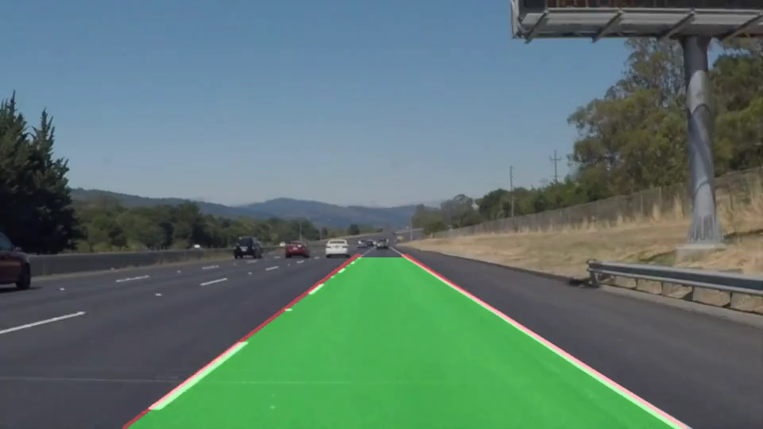
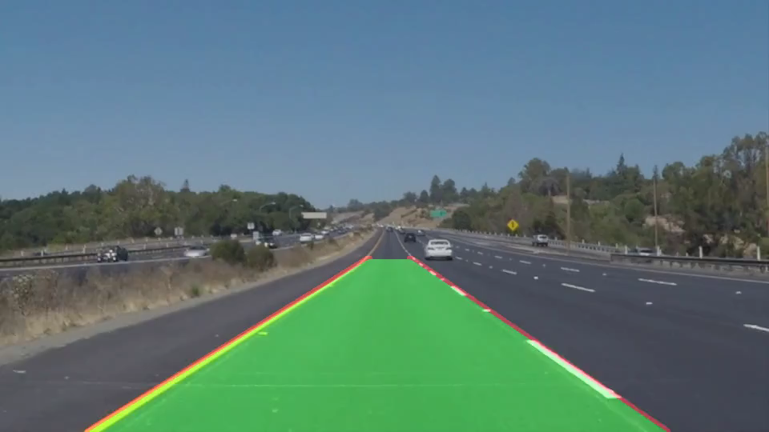
Results
WHITE LINE DETECTION
YELLOW LINE DETECTION

Slide 7
Future scope
This model is fit for straight lines if sudden curves arrives then this model will not work.
There are many roads which don’t have lane markings where this will not work,
so we are working on them.

Slide 8
REFERENCES & BIBLIOGRAPHY
• V• Shopa, P., N. Sumetha and P.S.K Pathra. “Traffic sign detection and recognition using OpenCV", International Conference on Information Communication and Embedded Systems (ICICES2014), 2014
• “Segnet: A deep convolutional encoder-decoder architecture for robust semantic pixelwise labelling,” arXiv preprint arXiv:1505.07293, 2015.
• J. Long, E. Shelhamer, and T. Darrell, “LANE DETECTION TECHNIQUES” – A Review.” in Proceedings of the IEEE Conference on Computer Vision and Pattern Recognition, 2015, pp. 3431–3440.
Articles:
• https://www.ncbi.nlm.nih.gov/pmc/articles/PMC6749518/
• https://www.frontiersin.org/articles/10.3389/fpsyg.2021.688376/full

Slide 9
Thank You

